Slide 1
Examining the Fastest Race in Swimming
Calvin Lutz

Slide 2
Background on the Race
  Shortest/fastest race in Swimming = 50 freestyle
  Two courses
    Short Course Yards “SCY” (25 yards/length)
    Long Course Meters “LCM” (50 meters/length)
  Most competitive meet in the world
    U.S. Olympic Trials
  Most competitive “league”
    NCCA Division I

Slide 3
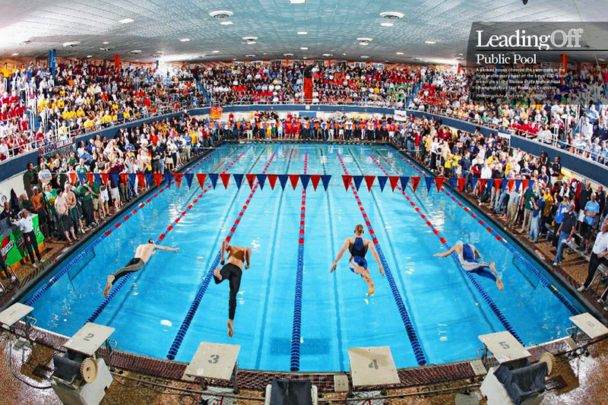
The Race
3 easily identifiable components
  Reaction Time
  Event Time
  Start
    Power
    Track
    Relay

Slide 4
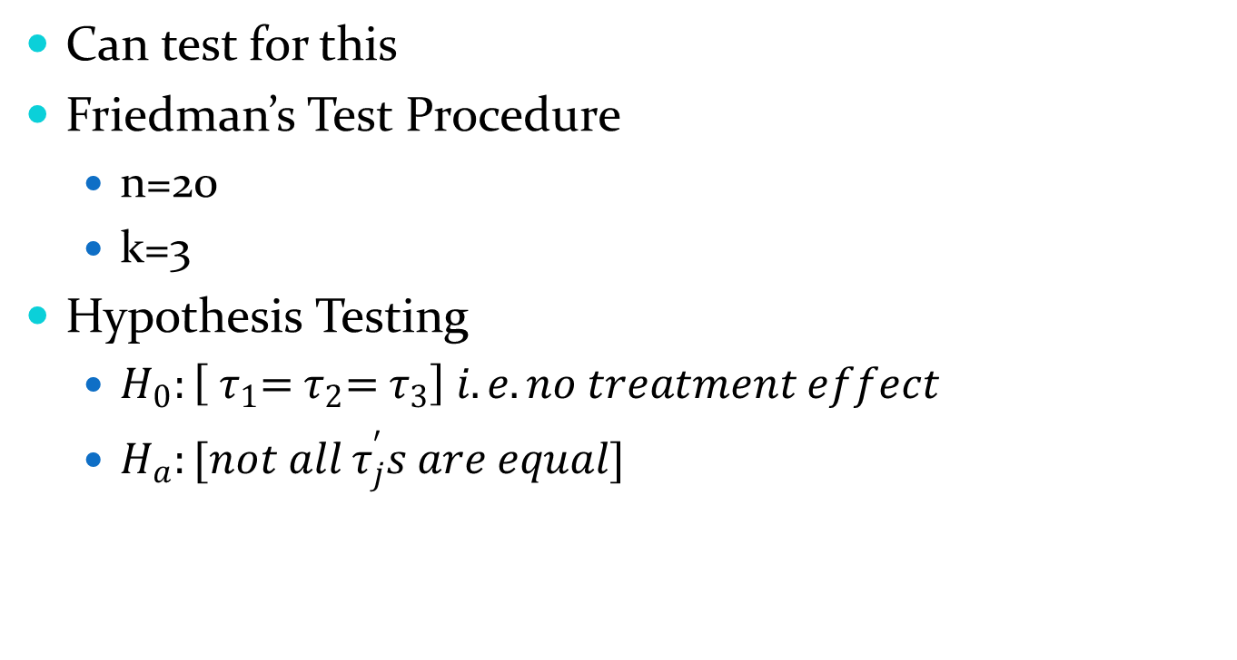
Differences between starts?
Can test for this
Friedman’s Test Procedure
  n=20
  k=3
Hypothesis Testing
  $H_{0}:\left[{ τ}_{1}={ τ}_{2}={ τ}_{3}\right] i.e. no treatment effect$
  $H_{a}:[not all τ_{j}^{′}s are equal]$

Slide 5
Data
Ohio State Invite SCY, November 2012
  http://grfx.cstv.com/photos/schools/osu/sports/m-swim/auto_pdf/2012-13/misc_non_event/113012-finals.pdf
2012 Olympic Trials LCM (for 2nd part)
  http://www.omegatiming.com/Competition?id=00010C0102FFFFFFFFFFFFFFFFFFFFFF&sport=AQ&year=2012

Slide 6
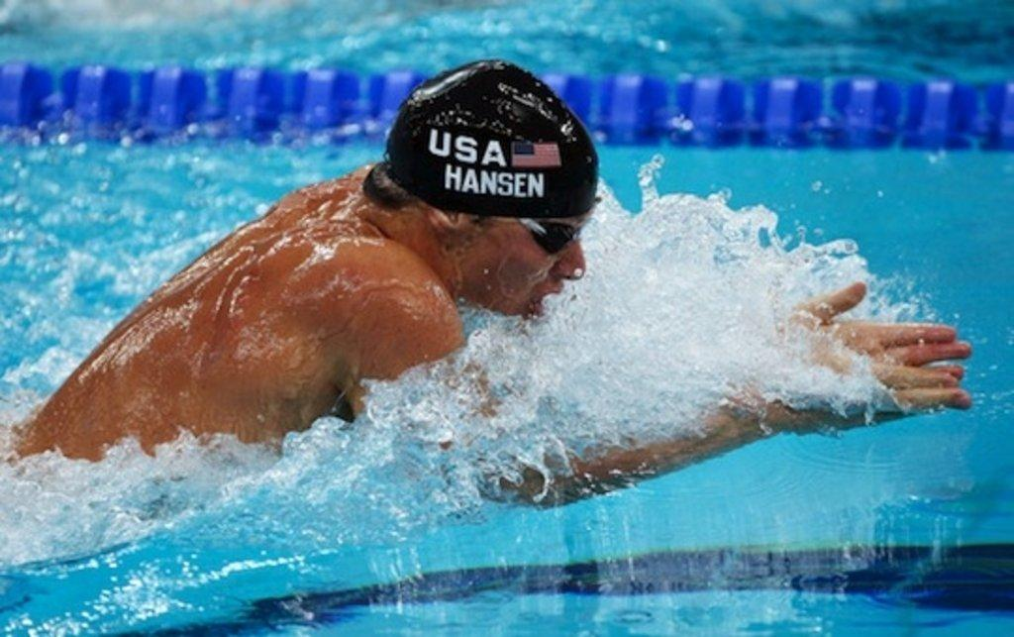
Why a Nonparametric Setting?
Blocking by swimmer
Could have large outliers, better to look at medians
Normality = NO

Slide 7
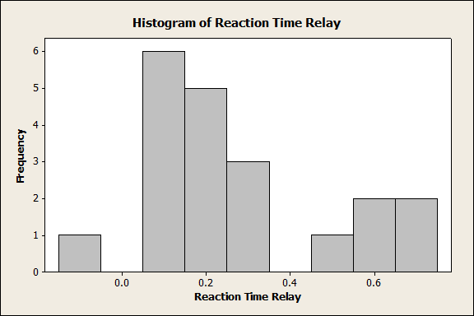

Slide 8
Friedman Results
S = 19.90 DF = 2 P = 0.000
Rejection of Null Hypothesis
Follow up with Multiple Comparisons

Slide 9
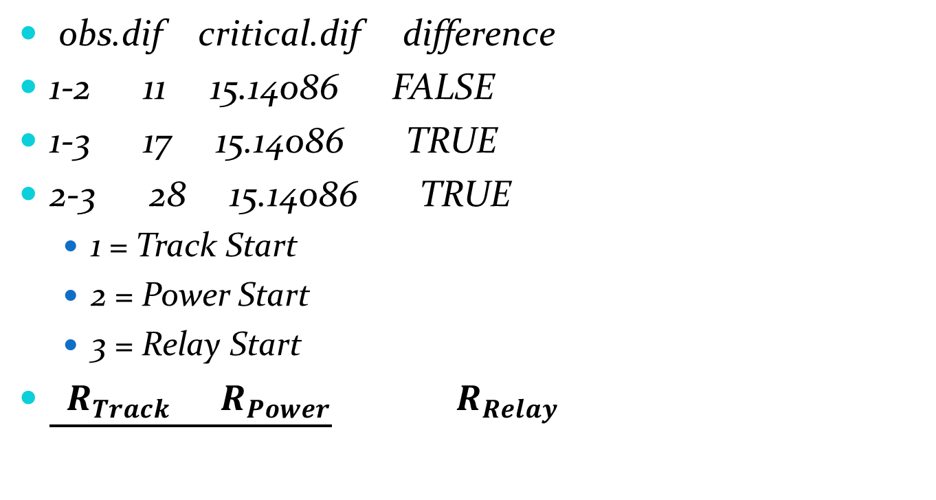
Follow Up Multiple Comparison
obs.dif critical.dif difference
1-2 11 15.14086 FALSE
1-3 17 15.14086 TRUE
2-3 28 15.14086 TRUE
  1 = Track Start
  2 = Power Start
  3 = Relay Start
$\underline{ R_{Track }R_{Power}}{ R}_{Relay }$

Slide 10
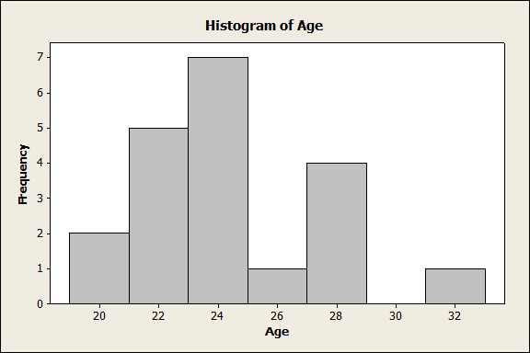
Comparing with OT Data
Again, use nonparametric setting due to the same reasons as DI.

Slide 11
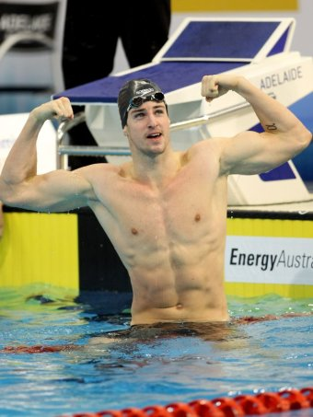
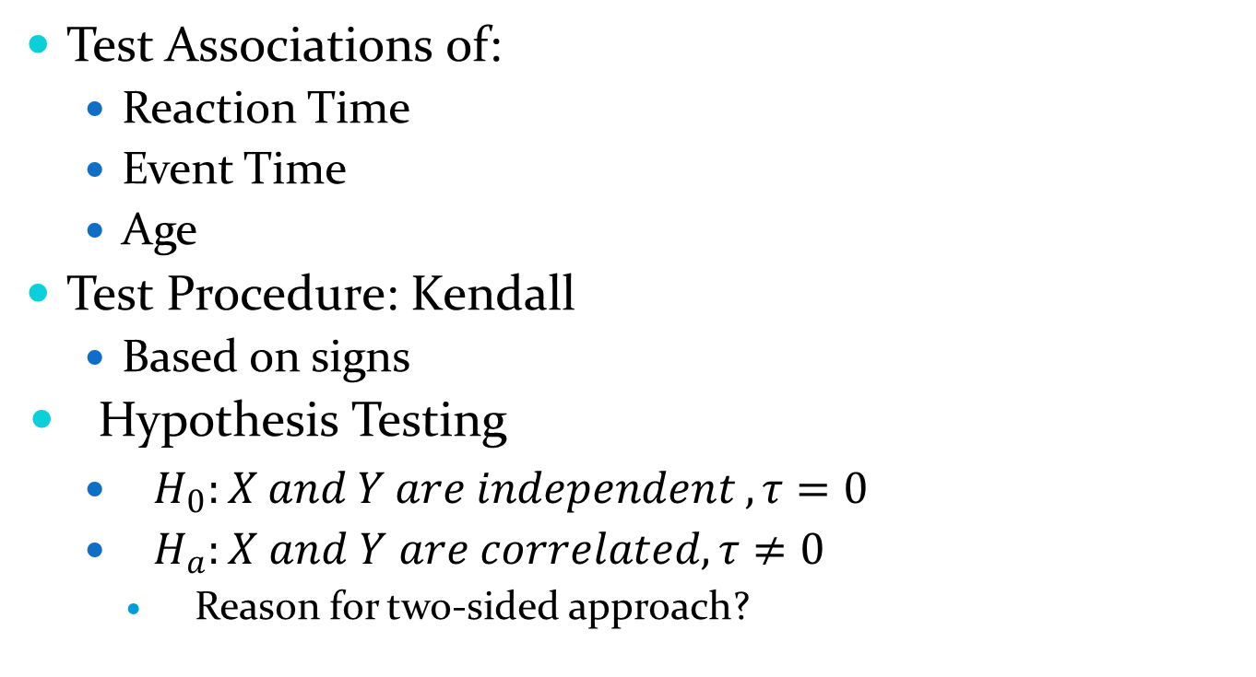
A Bunch of Repetition
Test Associations of:
  Reaction Time
  Event Time
  Age
Test Procedure: Kendall
  Based on signs
Hypothesis Testing
  $H_{0}:X and Y are independent , τ=0$
  $H_{a}:X and Y are correlated, τ≠0$
    Reason for two-sided approach?

Slide 12
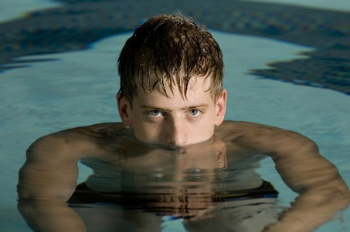

Reaction Time and Event Time
D1 Men
  $τ=\text{−0.04964124}$
  p-value = 0.7666
Olympic Trials: Men
  $τ=\text{−0.07698004}$
  p-value = 0.6456
Olympic Trials: Women
  $τ=\text{−0.0712781}$
  p-value = .6702

Slide 13
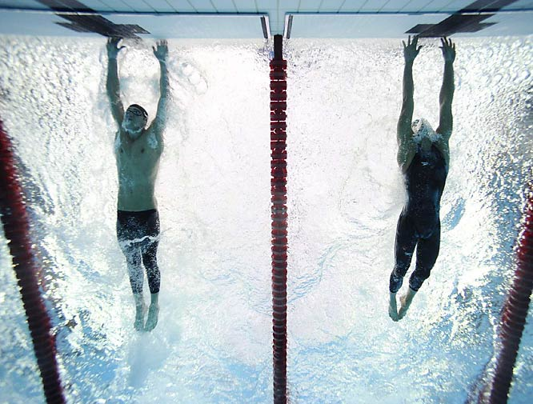

Age and Time
D1 Men*
  $τ=\text{−0.4428718}$
  p-value = .01278
Olympic Trials: Men*
  $τ=\text{−0}\text{.5309056}$
  p-value = .00162
Olympic Trials: Women**
  $τ=\text{−.2875738}$
  p-value = .08727

Slide 14
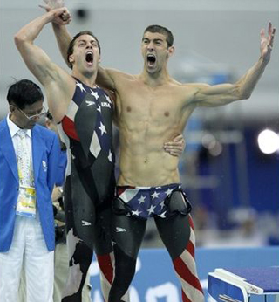

Reaction Time and Age
D1 Men
  $τ=\text{0.09536745}$
  p-value = .6035
Olympic Trials: Men
  $τ=\text{.1494278}$
  p-value = 0.3881
Olympic Trials: Women**
  $τ=\text{ −.3046027}$
  p-value = .07806

Slide 15
Summary of Significant Association
D1 Men
  Age and Time
Olympic Trials Men
  Age and Time
Olympic Trials Women
  Age and Time (.1 level)
  Reaction Time and Age (.1 level)

Slide 16
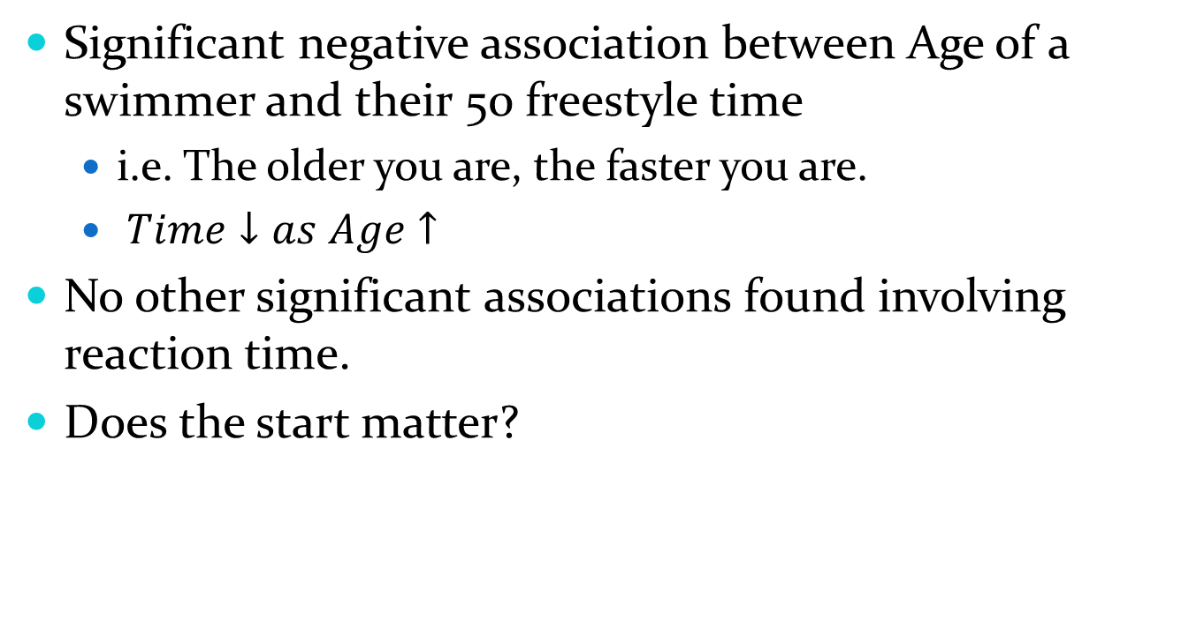
Conclusion
Significant negative association between Age of a swimmer and their 50 freestyle time
  i.e. The older you are, the faster you are.
  $Time↓as Age↑$
No other significant associations found involving reaction time.
Does the start matter?

